Slide 1
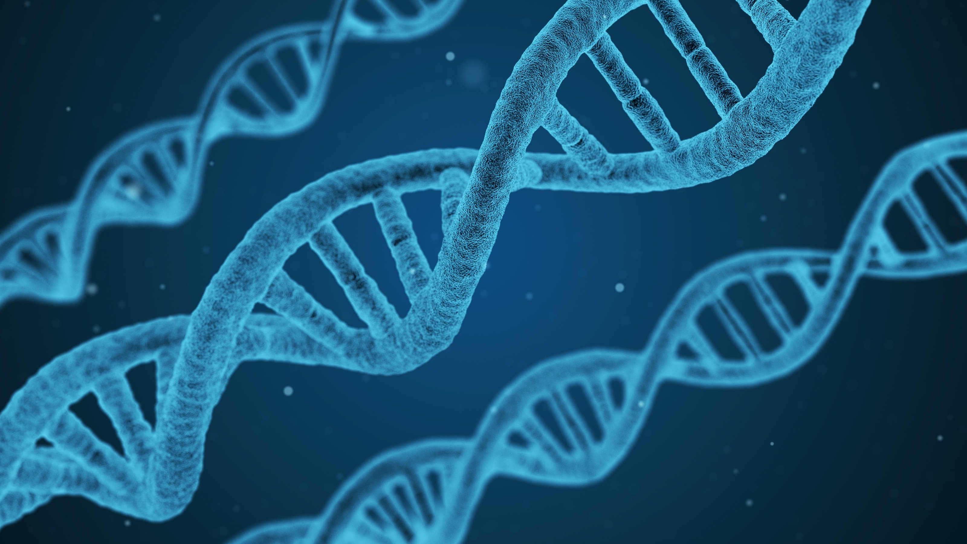
Cancer Genomics
Improving our understanding of canine cancers
Sophie Agger, PhD student
Monica Nielsen, PhD student
Notes:
So the overall topic is cancer genomics and I’ll just briefly summarise the basics before we move on to the projects.

Slide 2
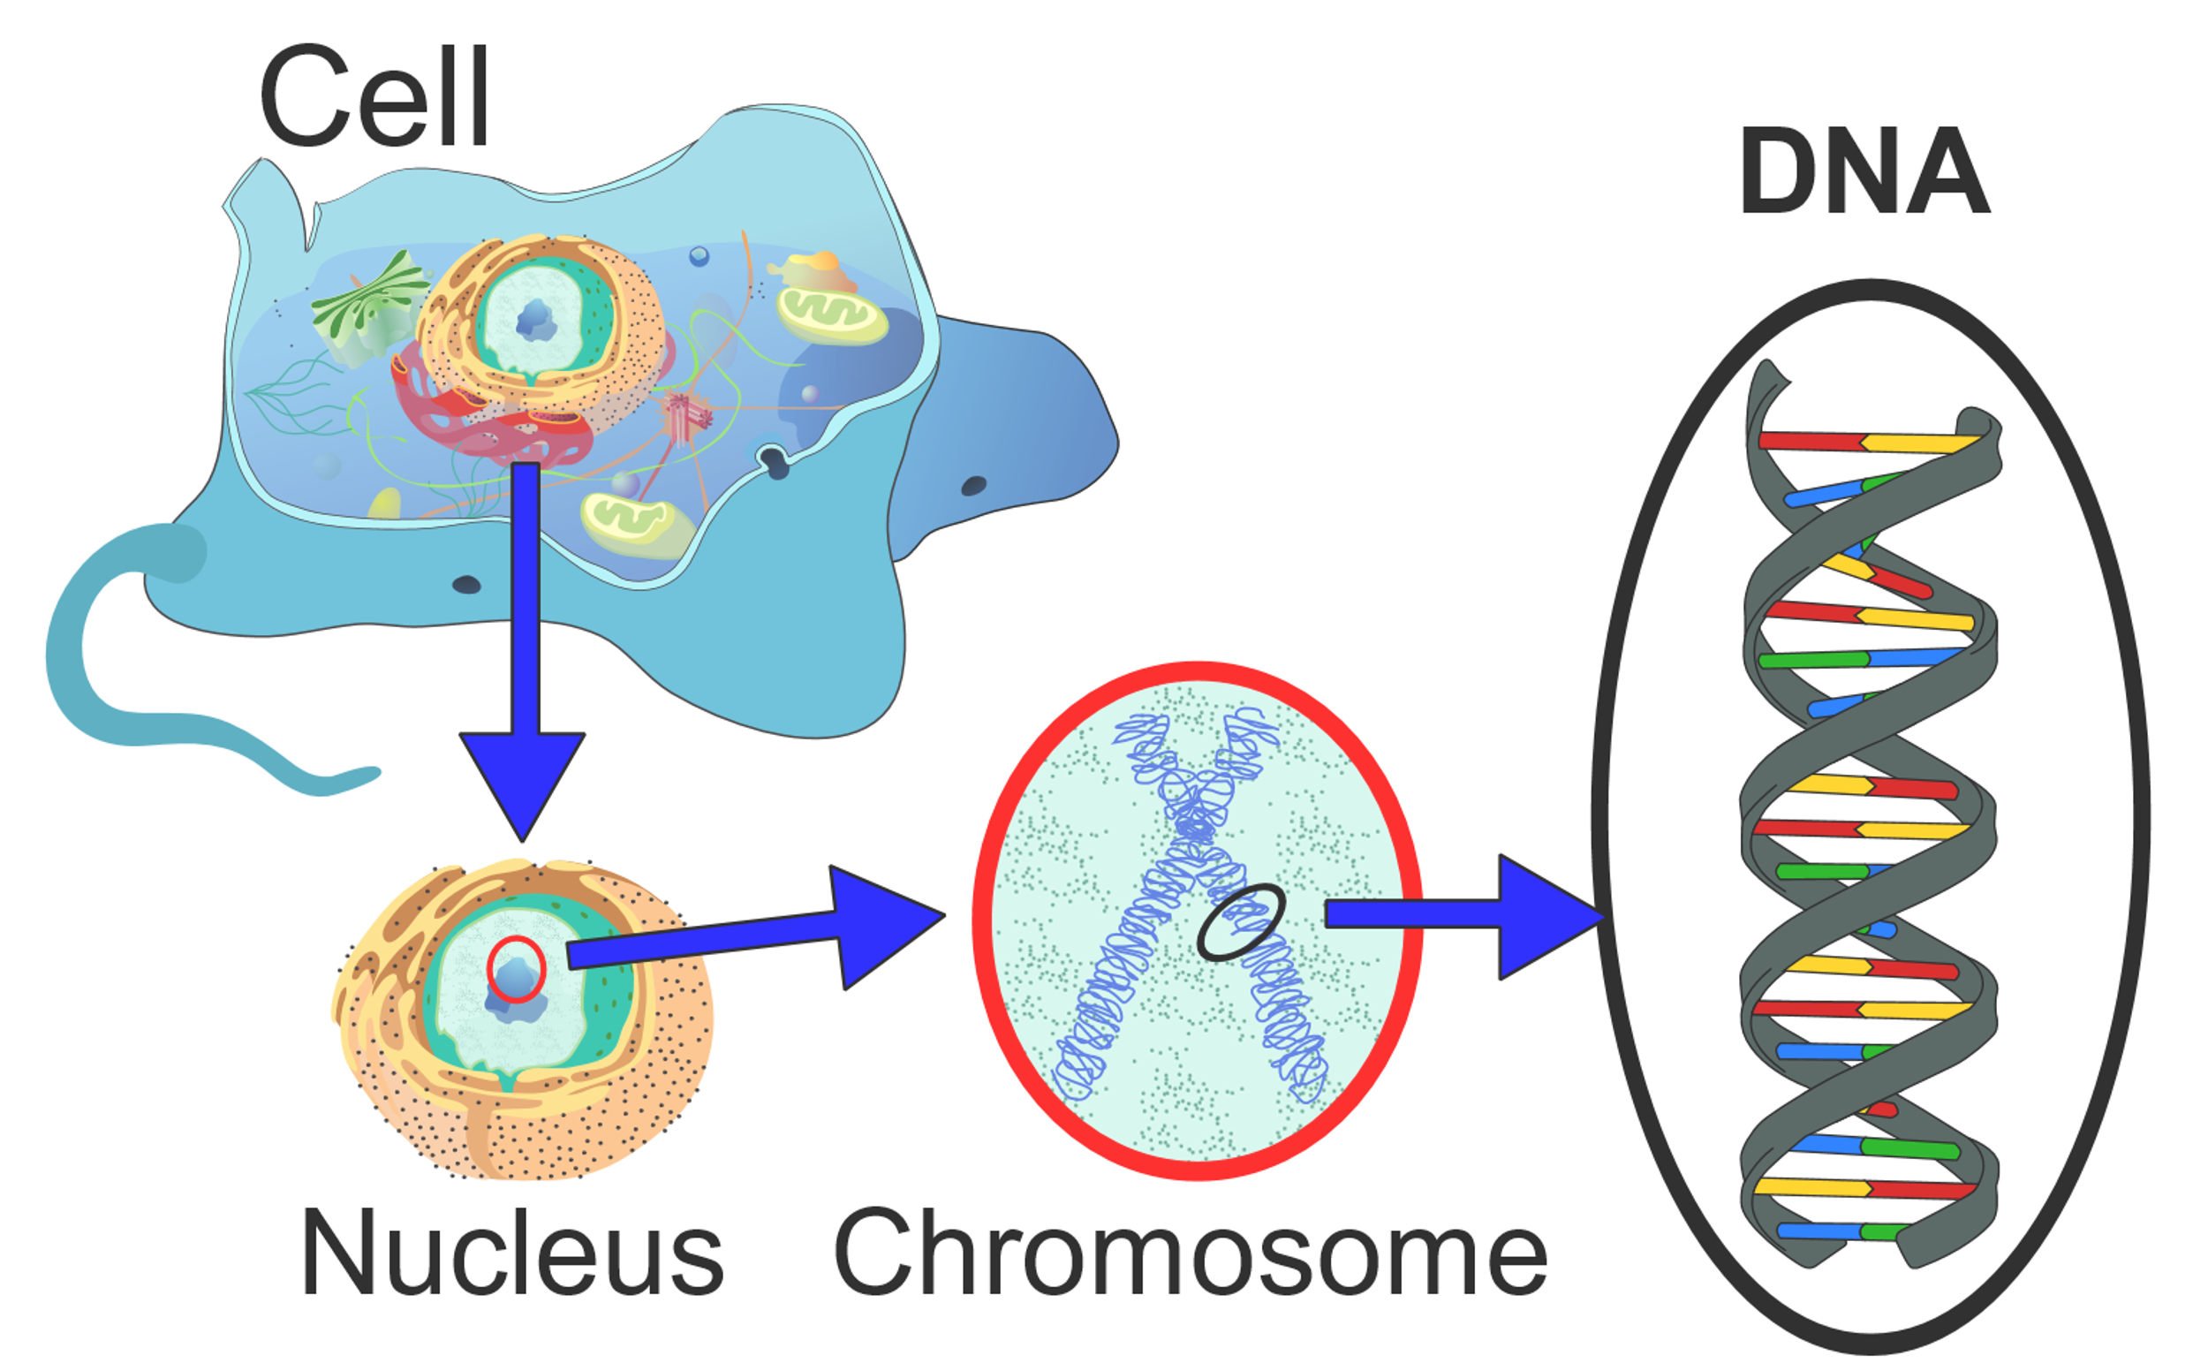
The cell
Notes:
Let me present to you; the cell.
We’re all made of cells. Inside the cell is the nucleus that contains our DNA which is the start of todays talk. The DNA consists of a pairs of nucleotides, always matched as A-T and C-G. The DNA contains all the information needed to build us.

Slide 3
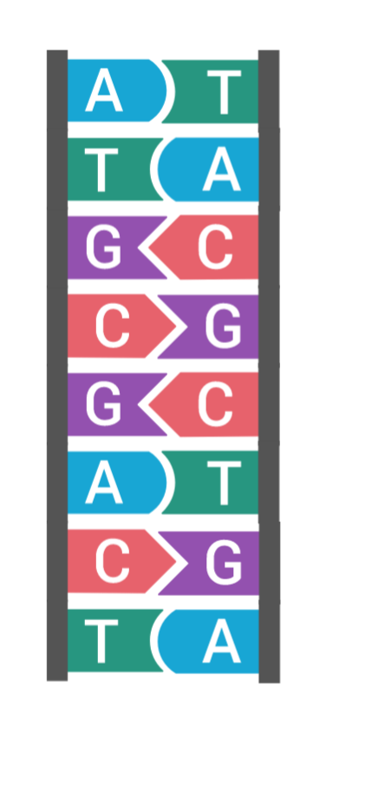
The cell
Notes:
Let me present to you; the cell.
We’re all made of cells. Inside the cell is the nucleus that contains our DNA which is the start of todays talk. DNA consists of a pairs of nucleotides, always matched as A-T and C-G and these strings of letters contain the information needed to build us.

Slide 4
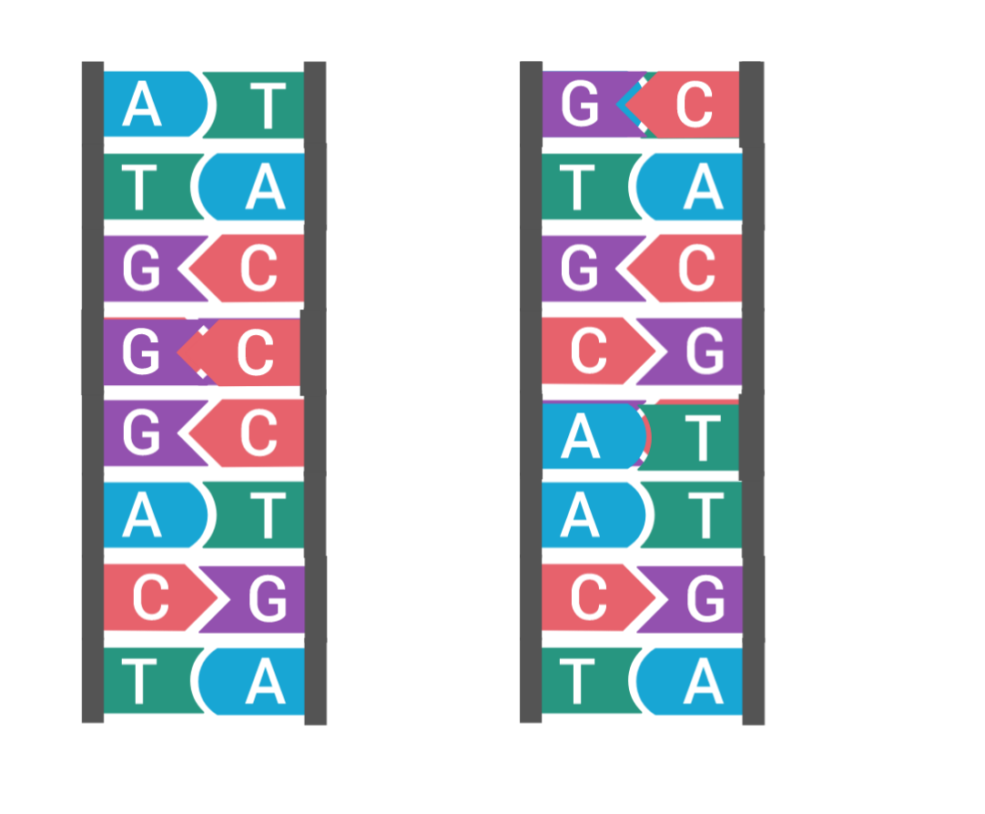
Germline variation
Dog 1 Dog 2
Individual differences /
Single Nucleotide Polymorphisms
Notes:
Each individual has a unique genomic makeup and most of the differences are changes of single basepairs, known as SNPs.

Slide 5

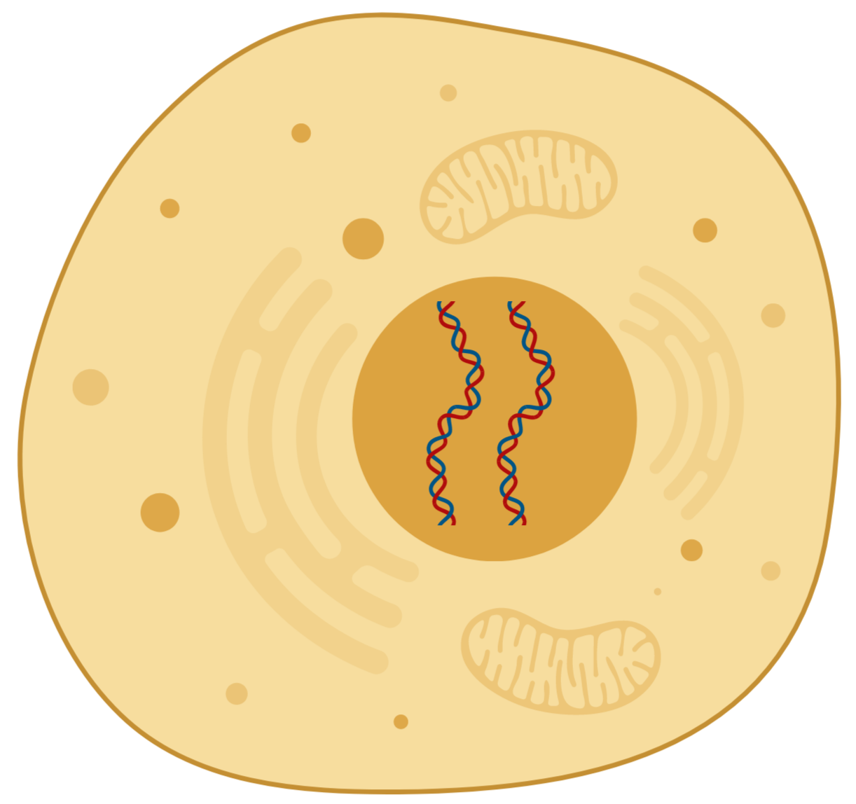
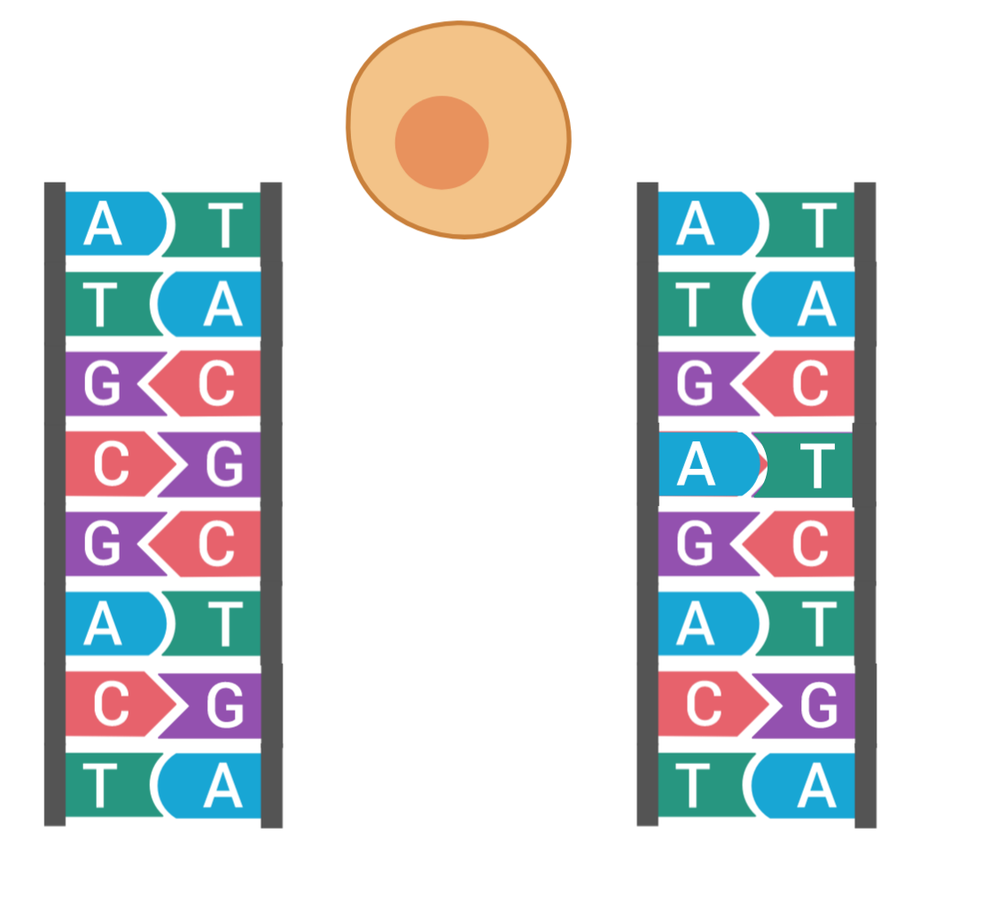
Somatic mutations
Notes:
However these changes can also occur in single cells, known as somatic mutations. This can happen by chance, but also if the DNA is damaged somehow.
These somatic mutations can be more or less deleterious, some of them are inocous and has no effects, while some can lead to further mutations.

Slide 6
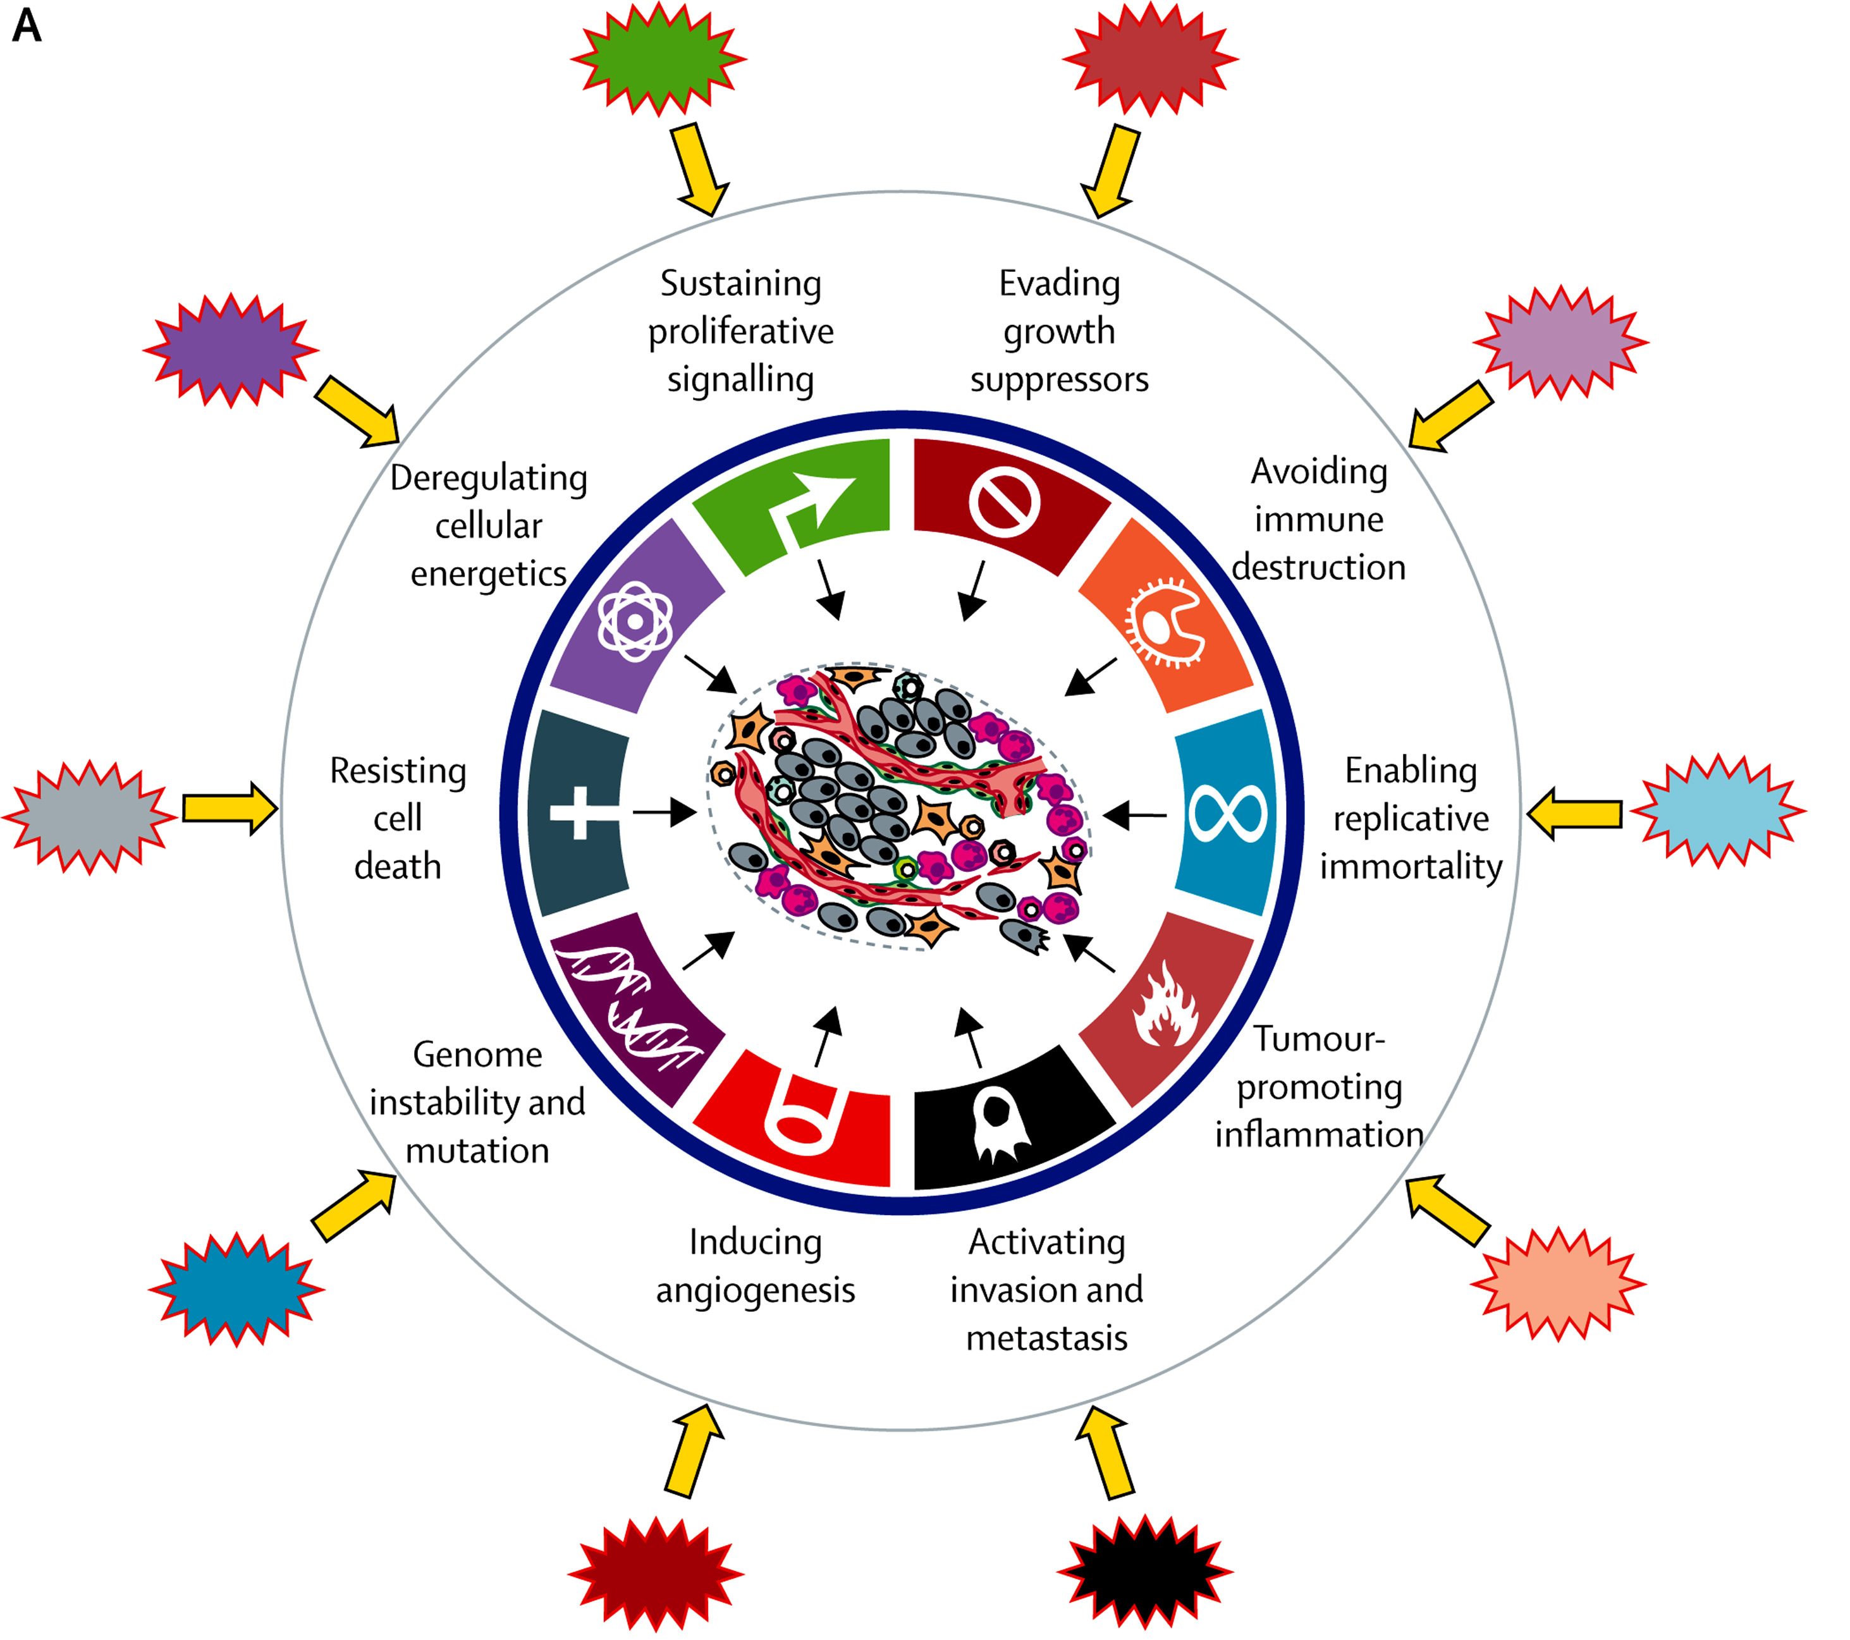

Development of cancer
The Lancet 2014 383, 558-563DOI: (10.1016/S0140-6736(13)62226-6)
Copyright © 2014 Elsevier Ltd Terms and Conditions
Notes:
Perhaps some of you remember the hallmarks of cancer, in order for a cell to become cancerous, these traits need to be aqcuired. I won’t go through all of them, but they all lead to loss of normal cellular regulation.
Many different mutations can lead to the auisition of these traits and the mutational patterns are useful for predicting prognosis and effectiveness of treatment.
A classic example of a tumor-driver mutation is mutations in the tumor supressor TP53. This gene encodes the protein p53 that is very important for cell maintenance by reacting to DNA damage.
P53 reacts to DNA damage in several ways. It activates DNA repair mechanisms and can stop the cell cycle until DNA damage is fixed. Thus, a loss of function in this gene can lead to genomic instability and an increased risk of further mutations.
So. How does mutations in general relate to cancer?

Slide 7
Development of cancer
Mutational patterns in tumors are useful for predicting behavior and effectiveness of treatment
The Lancet 2014 383, 558-563DOI: (10.1016/S0140-6736(13)62226-6)
Copyright © 2014 Elsevier Ltd Terms and Conditions
Notes:
And this is what we want to investigate further.

Slide 8
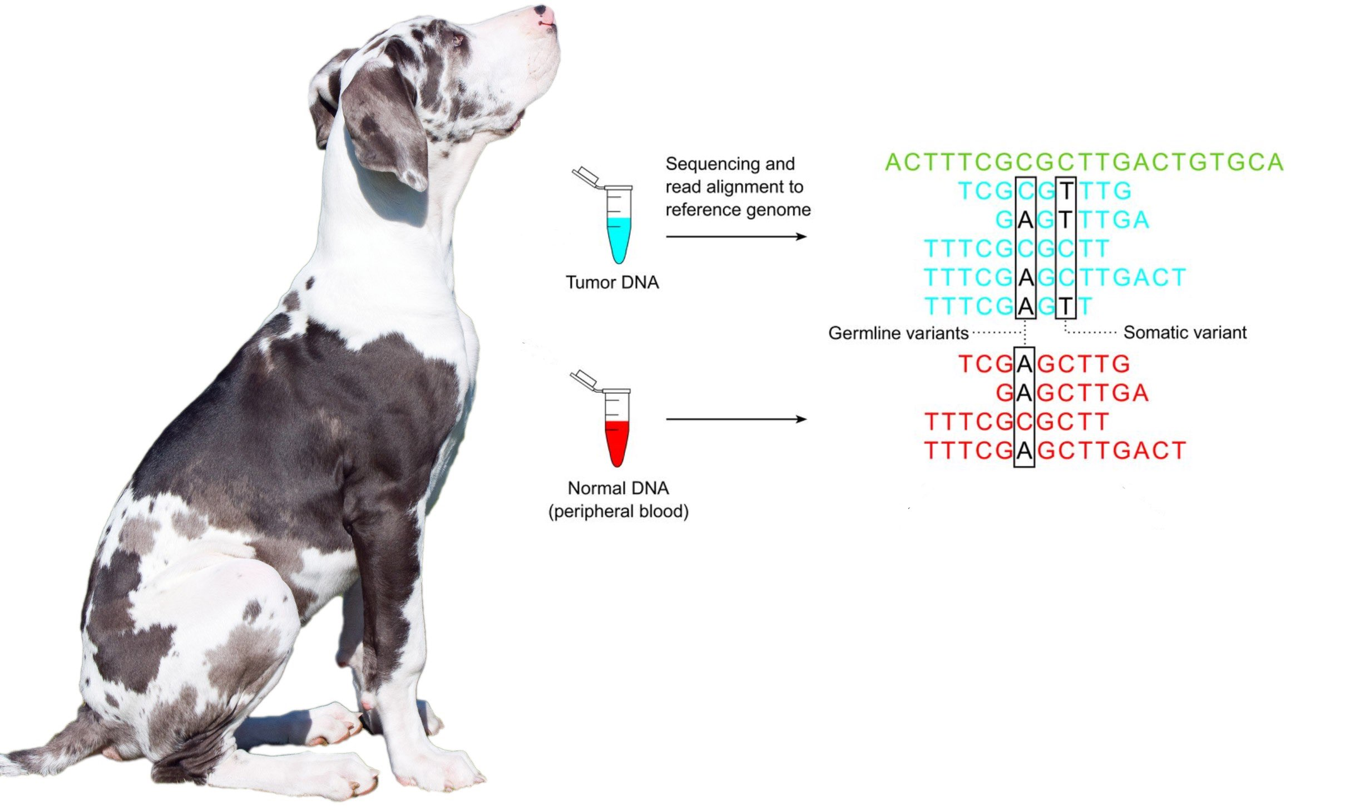
Method
Tumor mutations
Genetic variation
Edited from publicdomainpictures and http://clinchem.aaccjnls.org/content/59/1/127
Notes:
And how are we doing this?
The short version is that to find which mutations are present in the tumor, we look at all the variation found in the tumor and subtract the variation found in the normal cells

Slide 9
Method
Tumor mutations
Genetic variation
Mutations in tumor – individual variation =
Somatic mutations
Edited from publicdomainpictures and http://clinchem.aaccjnls.org/content/59/1/127
Notes:
And how are we doing this?
The short version is that to find which mutations are present in the tumor, we look at all the variation found in the tumor and subtract the variation found in the normal cells.
These mutations are the mutations found only in the tumor and they (or some of them) are the underlying reason for development of cancer.

Slide 10
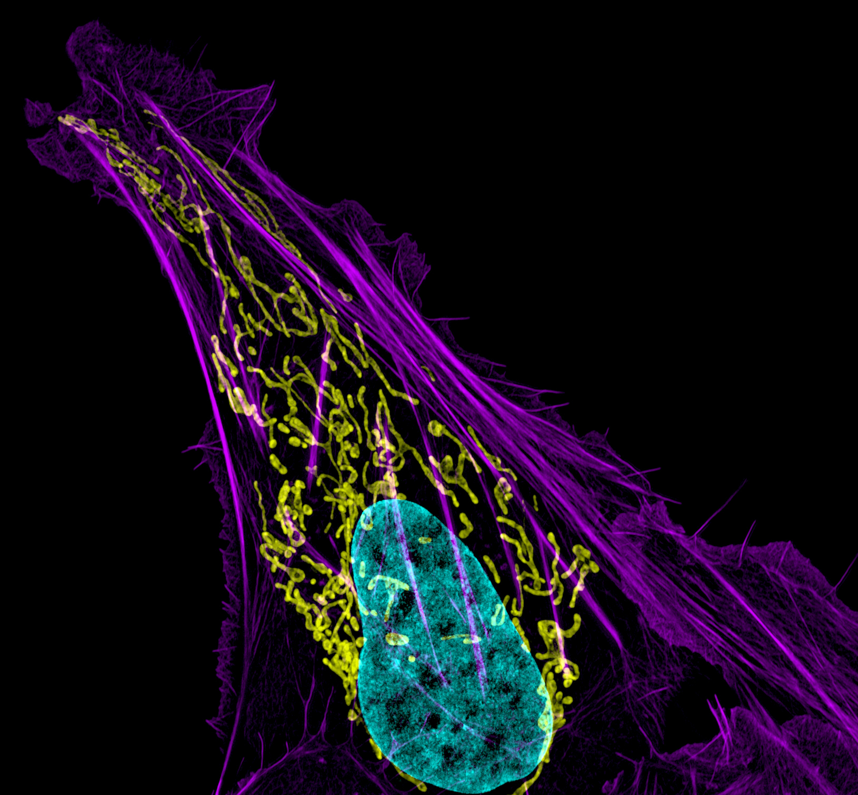
Somatic mutations in canine cancers
A Dog Oncology and Genome project (D.O.G)
Sophie Agger, PhD student
Supervisors:
Associate professor Maja Arendt, DVM, PhD, DipECVIM-CA(onc) Professor Annemarie T. Kristensen, DVM, PhD, DACVIM-SA, DipECVIM-CA, DipECVIM-CA(onc)
Professor Kerstin Lindblad-Toh, PhD
Dylan Burnette and Jennifer Lippincott-Schwartz, Eunice Kennedy Shriver National Institute of Child Health and Human Development, National Institutes of Health
Notes:
So my PhD project is a part of a much larger - and ongoing project partially funded by the NIH – the dog oncology and genome project. This is a multinational (Scandinavia, and US) project and the overall goal for the project is to improve the knowledge about the genetic background of canine cancers.
I’m involved in 2 different clinical studies, 1 where I’m just a part of the study and where we’re looking at these mutational patterns for mammary tumors, osteosarcoma and lymphoma. The other study is a longitudinal study of mammary cancer which I’ll discuss a little bit later.
This image shows an osteosarcoma cell with DNA in blue, mitochondria in yellow, and actin filaments, part of the cellular skeleton, in purple.

Slide 11

Background
Improve understanding of cancer
Osteosarcoma
Lymphoma
Mammary tumors
Notes:
So, the first the project looks at the somatic mutations found in osteosarcomas, lymphomas, and mammary tumors.
Both osteosarcoma and lymphoma has a bad prognosis in general, there are a lot of mammary tumors and breast cancer and thus, all 3 tumor types have a very high impact on both dogs and humans.
Right now it’s hard to compare data between dogs andhumans, as the canine classification is primarily based on histopathology, while the human is mostly molecular in nature
While the project focuses on investigating the canine forms, the information can also help human cancer patients by enhancing the dog as a model for human disease but also by gaining more knowledge in general about the subtypes present in both species.
Describing the mutational landscape in order to:
Improve subtyping
Improve understanding of the cancers
Improve the dog as a model for human disease
Correlate mutational patterns with clinical characteristics
Better prognostication and treatment options

Slide 12
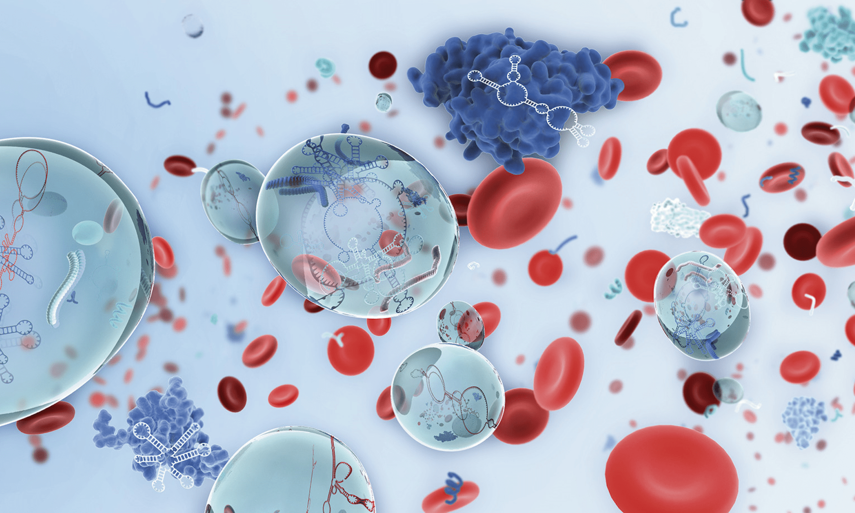
Brugen af flydende biopsier til klassifikation af hjernetumorer hos hunde
Ph.D projekt
Monica Nielsen, Ph.D. studerende
Vejledere:
Lektor Maja Arendt, DVM, PhD, DipECVIM-CA(onc)
Lektor Hanne Gredal, DVM, PhD
Professor Merete Fredholm, DVM, PhD, Dr.Vet.Sci
Lisa Alves, DVM, PhD, DipECVIM
Jane Dobson, DVM, DipECVIM-CA
Faculty David Adams, B.Sc, PhD, F.Med.Sci
Image: QUIAGEN

Slide 13
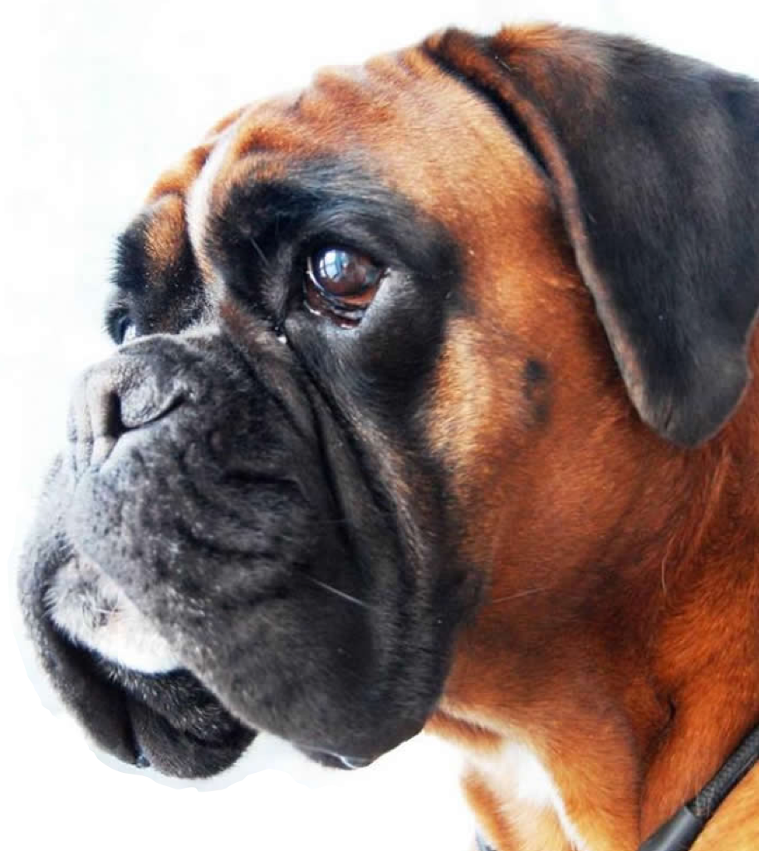
Hjernetumorer hos hunde
Flere forskellige sygdomme
Ikke ualmindeligt forekommende (op til 4,5%)
Voksne og seniorhunde
Brachycephale racer overrepræsenterede
Svære at diagnosticere og behandle.
Song et al., 2013: Postmortem Evaluation of 435 Cases of Intercranial Neoplasia in Dogs and Relationship of Neoplasm with Breed, Age, and Body Weight

Slide 14
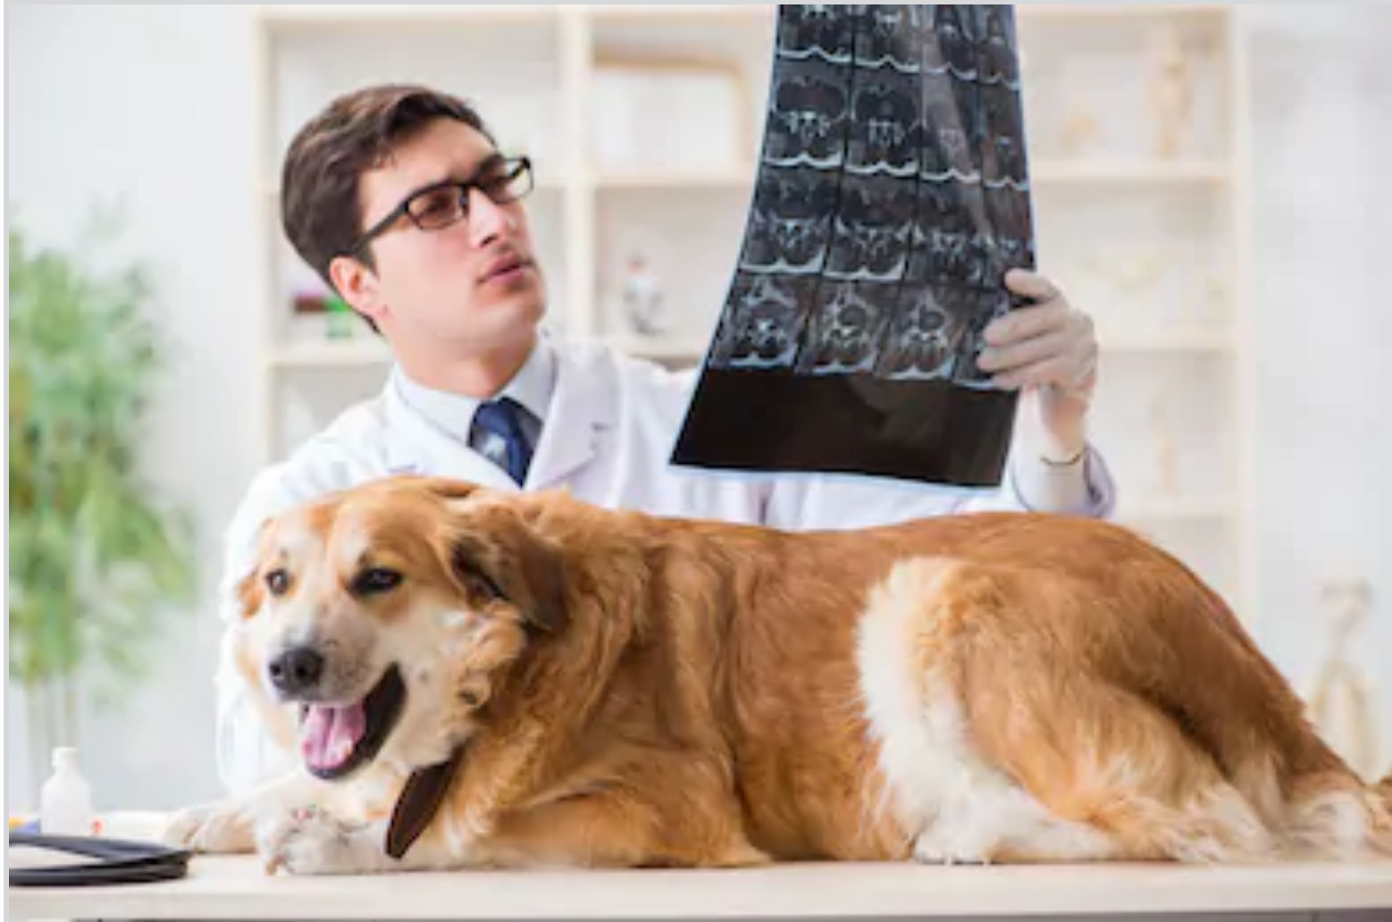
Hvis en hund mistænkes for en hjernetumor
Grundig klinisk & neurologisk undersøgelse
Hjernescanning
Blodprøver mm.
Biopsi

Slide 15
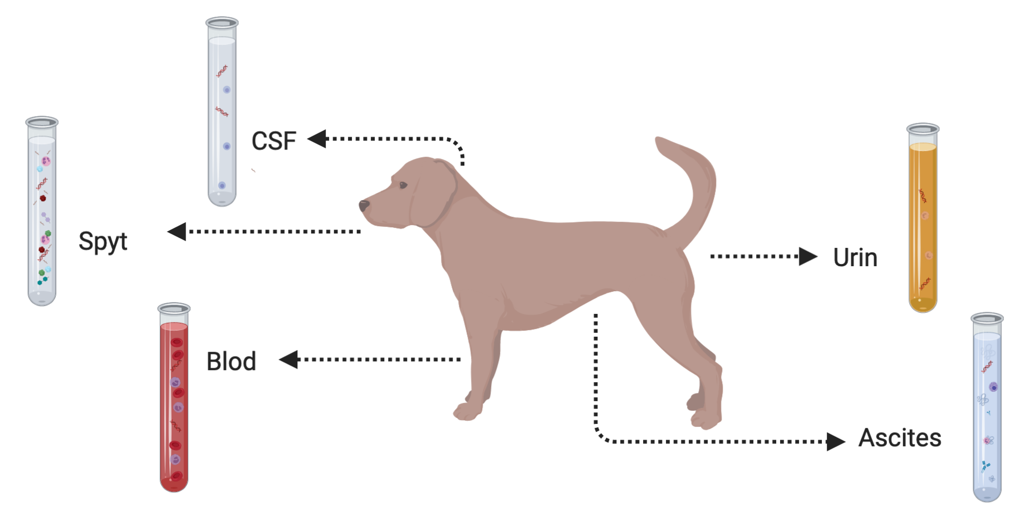

Flydende biopsi

Slide 16
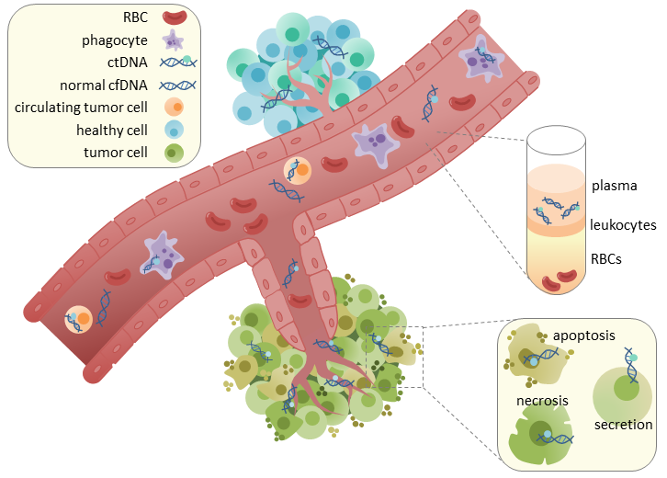
Genetiske kræftmarkører i blodbanen

Slide 17
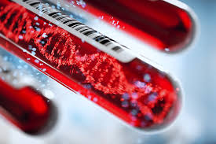
Forskningshypotese
Vi kan bruge flydende biopsier i form af blodprøver og rygmarvsvæskeprøver til at klassificerer hjernetumorer hos hunde

Slide 18
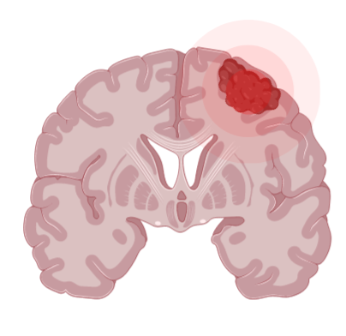


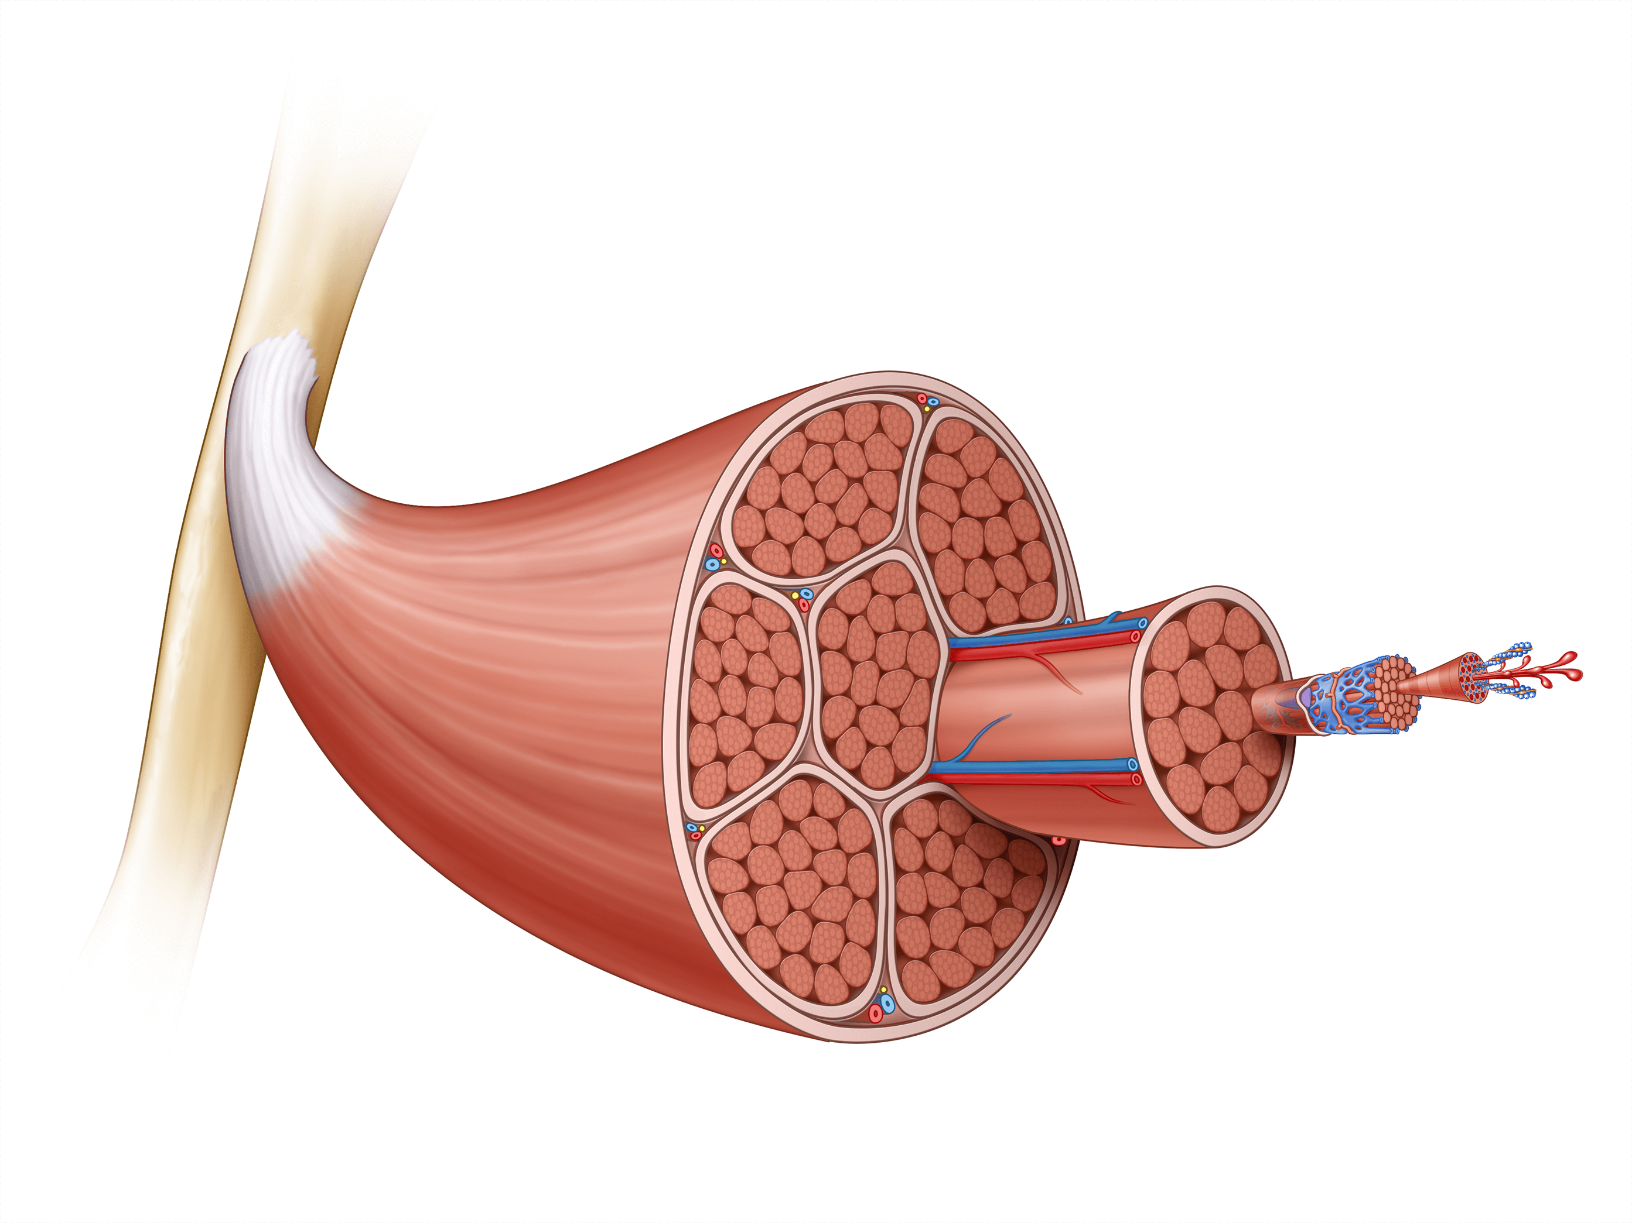


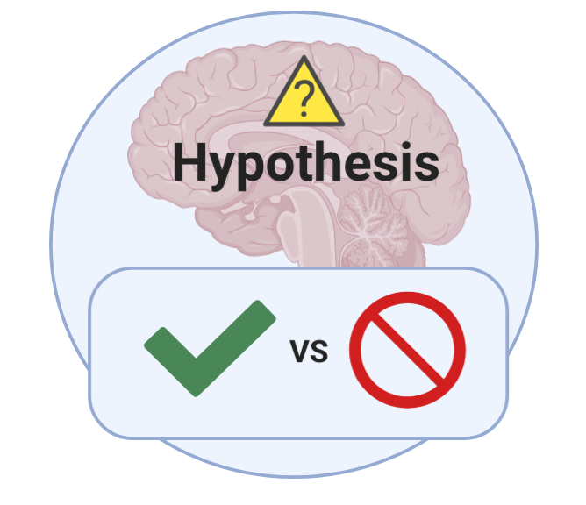
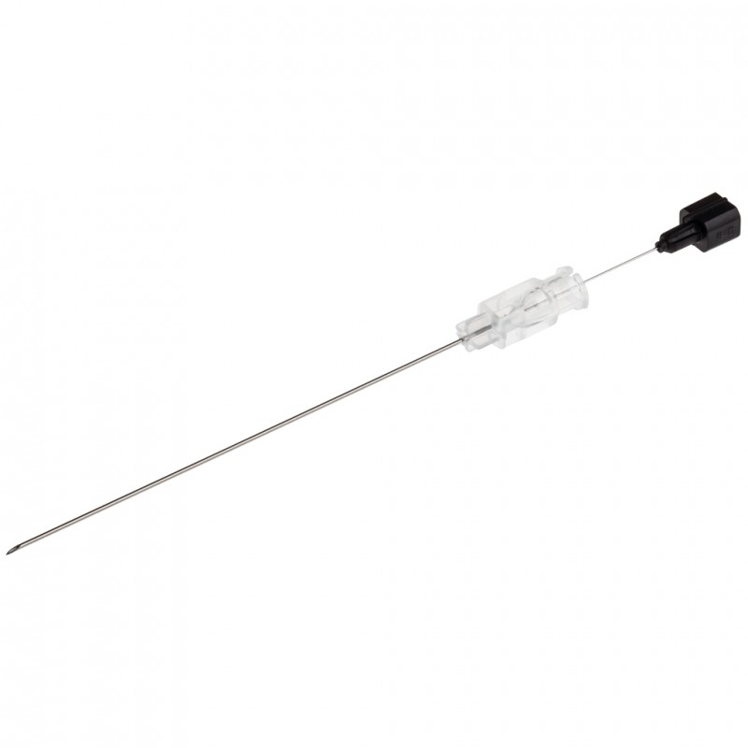
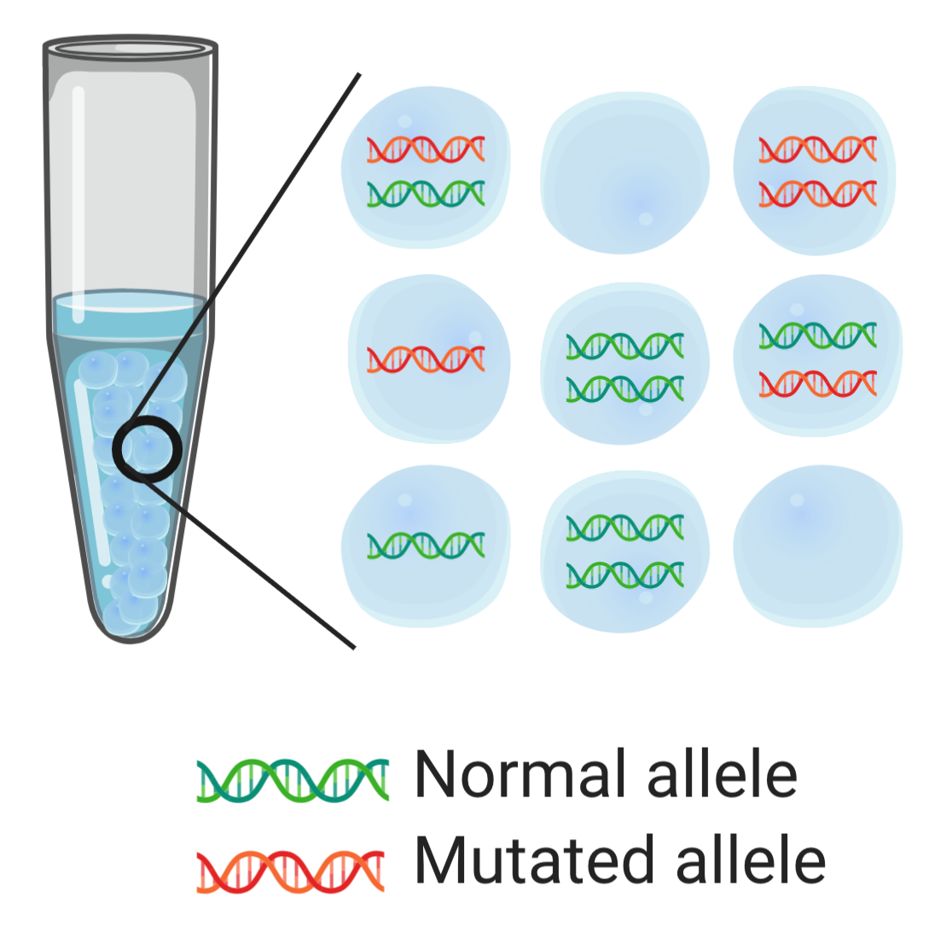
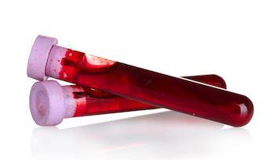
GGAAACCTTAG
GGAAACCGTAG
Liste over tumor- specifikke mutationer

Slide 19
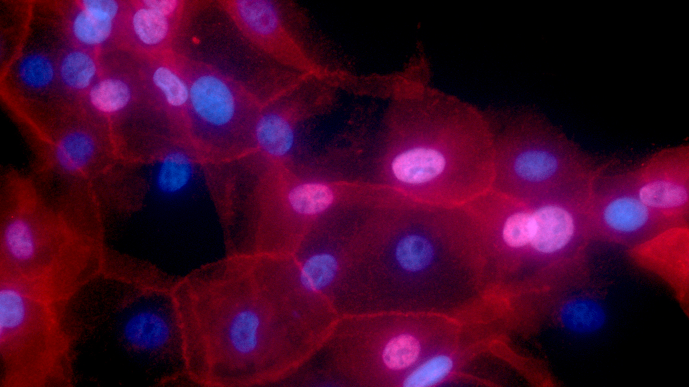
Liquid biopsies as a tool for tracking canine mammary tumors
Sophie Agger, PhD student
Supervisors:
Associate professor Maja Arendt, DVM, PhD, DipECVIM-CA(onc) Professor Annemarie T. Kristensen, DVM, PhD, DACVIM-SA, DipECVIM-CA, DipECVIM-CA(onc)
Professor Kerstin Lindblad-Toh, PhD
Credit: Ewa Krawczyk, National Cancer Institute \ Georgetown Lombardi Comprehensive Cancer Center, National Institutes of Health
Notes:
The image shows cell culture of human breast cancer conditionally reprogrammed cells. Fluorescence red color represents MHC-I, and nuclei are shown in blue.

Slide 20
Study design
2 m 4 m 6 m 8 m 10 m 12 m
18 m
Biopsy of tumor
Blood sample
Clinical examination
Histopathology
Tumor DNA
Restaging is performed
when clinically relevant
Blood sample
Normal DNA
ctDNA
ctDNA
Notes:
Right now, it’s hard to follow disease progression of cancers due to the relative low sensitivity and invasiveness of imaging modalities. We’re looking into following disease progression using liquid biopsies. The idea is to find tumor-specific mutations in the tumor and then looking for these in the liquid biopsy.
The focus is to 1) is it present 2) is it useful for tracking mammary tumor progression and tumor evolution.
Prove that ctDNA is present in dogs with aggressive mammary tumors
Follow the levels of ctDNA over time
Is ctDNA present before metastasis / regrowth is observed by conventional means?
Follow evolution of mutations over time – f.eks. For metastasis, thecells needto be able to: Go through basal membrane and invade new tissues. Tthese muttations are not necessarily present in the primary tumor.
Is the mutational pattern the same at diagnosis and at relapse?

Slide 21






Call us if you have a patient with:
Mammary tumor(s)
Osteosarcoma
Lymphoma
Brain tumor(s)
Euthanasia is NOT an exclusion criteria
Sophie Agger
Mail: sesa@sund.ku.dk
Tlf: 26 35 06 74
Monica Nielsen
Mail: moni@sund.ku.dk
Tlf: 93 51 60 40

